Slide 1
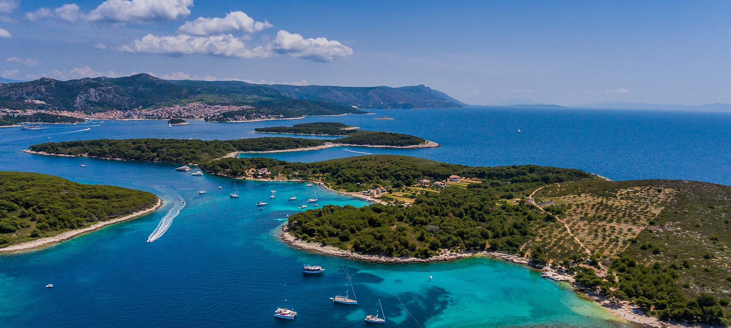
The Pearls of DALMATIA

Slide 2
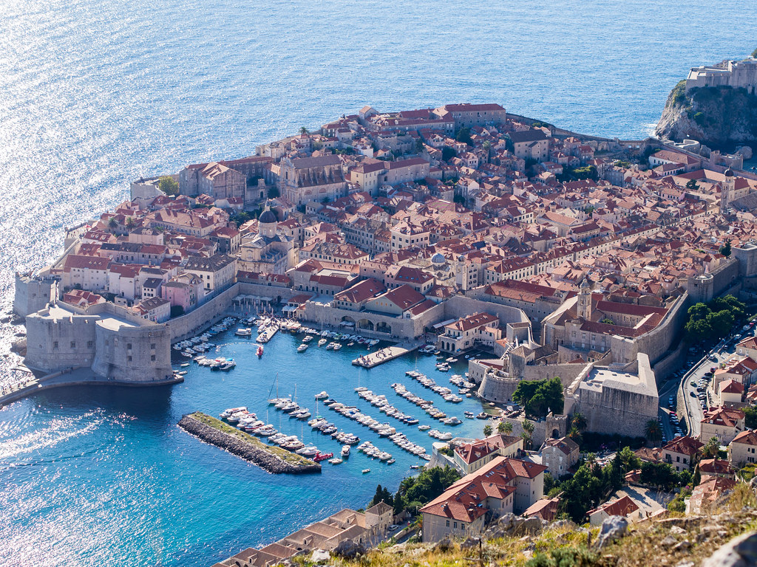
Dubrovnik
If you want to see paradise on earth, come to Dubrovnik. -George Bernard Shaw

Slide 3
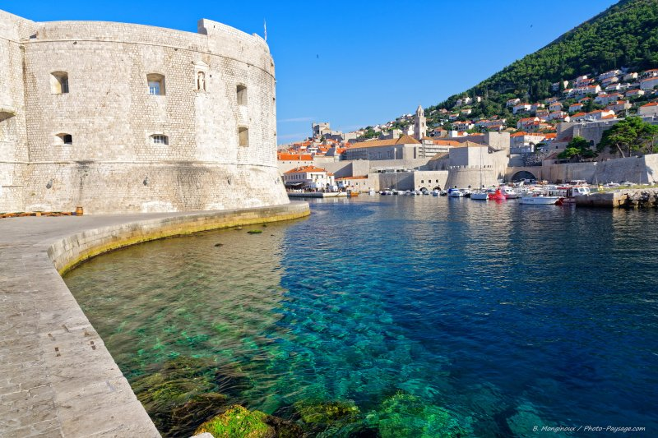
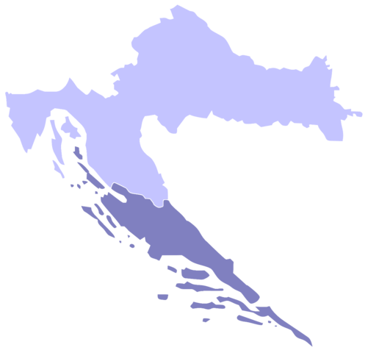
Dubrovnik is a beautiful, historical Croatian city.
It is located on the Adriatic coast, in the south of Croatia and is one of the most important cultural and tourist centers in Southeast Europe!
Dubrovnik is famous for its amazing views and sea

Slide 4
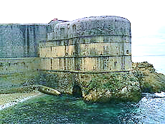
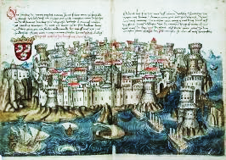
There are several theories about the founding of Dubrovnik. The first one is that the town was founded in the 7th century, and the second one is that it may have been founded before the 3rd century, as a small settlement on the islet of Laus. It was first mentioned in 850. Dubrovnik is enclosed by walls construction began in the 13th century and ended in the 17th century. The walls served as a defense in the war, which is why they were built at high speed.
History of Dubrovnik
Republic of Dubrovnik

Slide 5
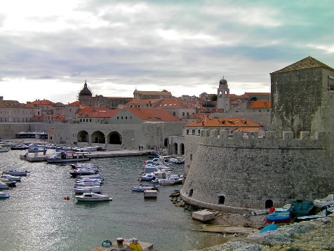
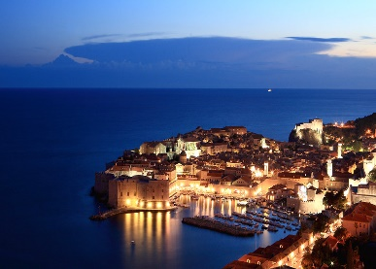
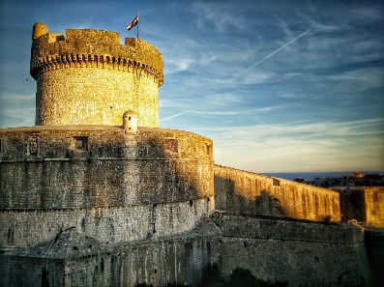
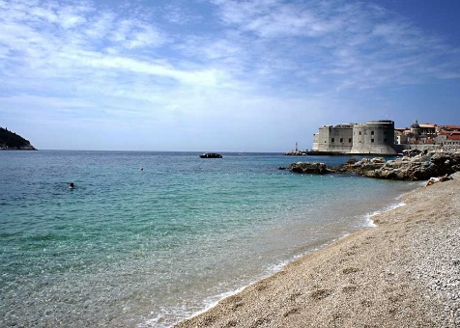
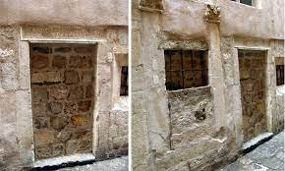
ABOUT DUBROVNIK
In 1979, UNESCO added the city of Dubrovnik in the list of World Heritage Centers.
Dubrovnik attracts over 1 million tourists per year.
Some scenes from famous shows; Game of thrones, Star Wars and Robin Hood were filmed in Dubrovnik.
The symbol of Dubrovnik is tower Minčeta.
Dubrovnik had the first orphanage in the world, which opened its doors to take in children in 1432.
This city attracts many tourists because of its beaches and around 7.2 hours of sun per day.

Slide 6
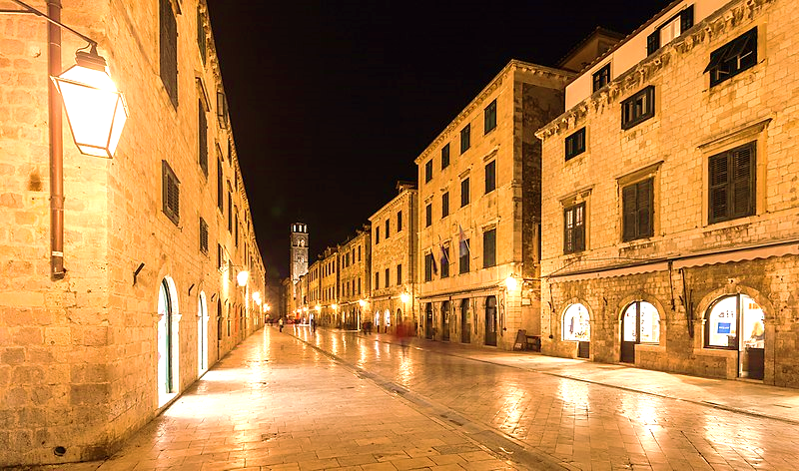
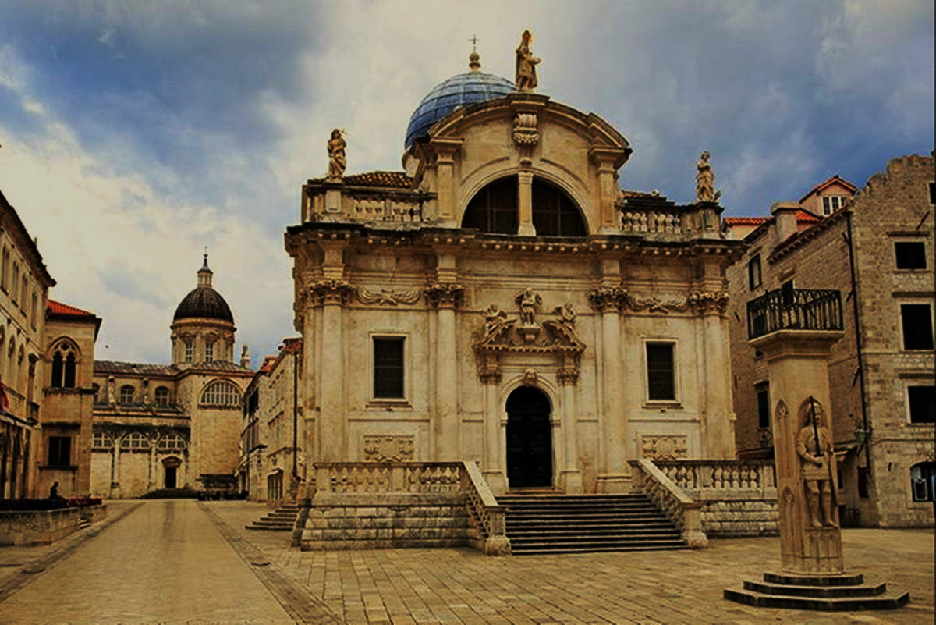
One of the most beautiful places in Dubrovnik is Stradun. It is the main shopping street and square. You can see fountains and bell towers from there.
STRADUN
The Franciscan monastery is the first pharmacy in Europe that also surrounds Dubrovnik's oldest garden. It is famous for its amazing art museum and Gothic arhitecture.
FRANCISCAN MONASTERY
CHURCH OF ST. BLAISE
There are many beautiful churches in Dubrovnik including that of the patron Saint Blaise. The church was built in Baroque style.

Slide 7
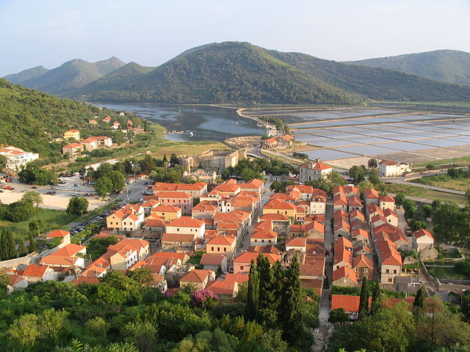
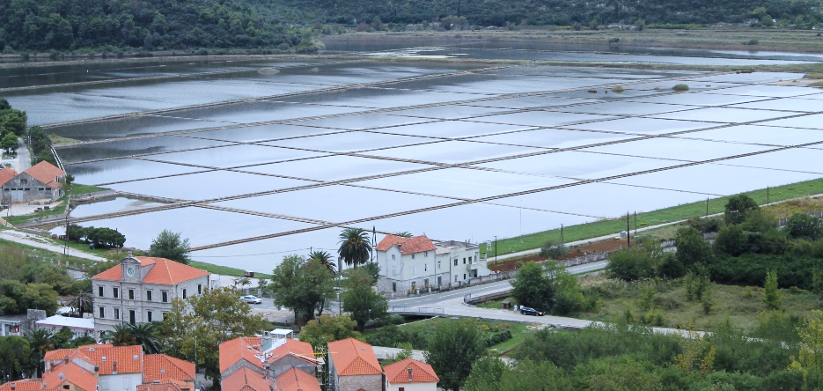
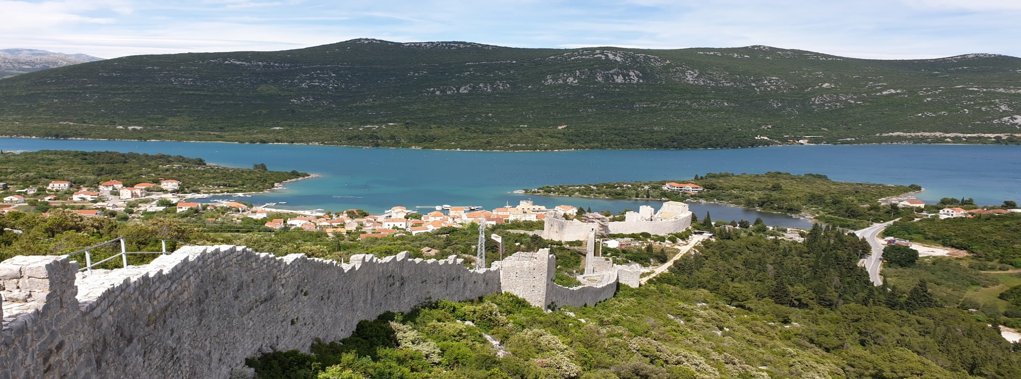
Ston is a settlement near Dubrovnik located on the peninsula of Pelješac.
STON
Saltwork in Ston is the oldest in Europe and possibly in the world. It dates back to the 14th century and is now operational.
The walls of Ston ,with their length of 5.5 km, play the role of the second longest walls in the world. They were made for the defence of Ston in the 14th century.

Slide 8
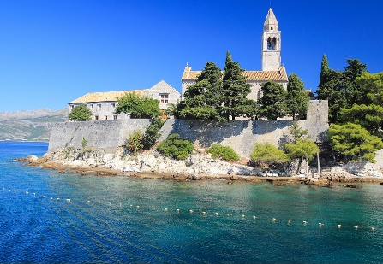
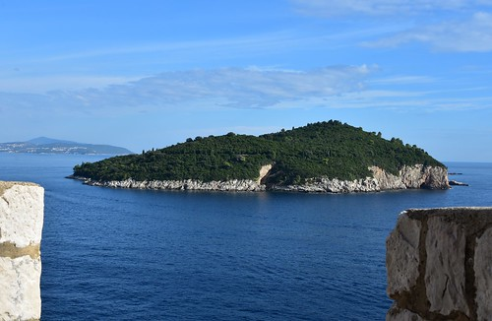
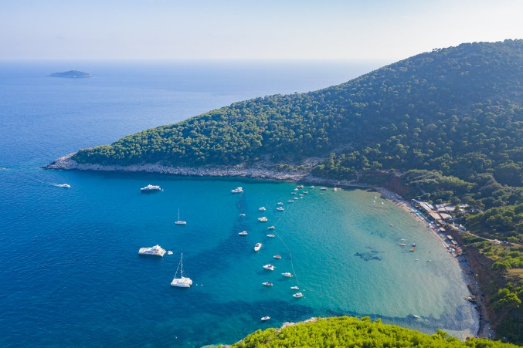
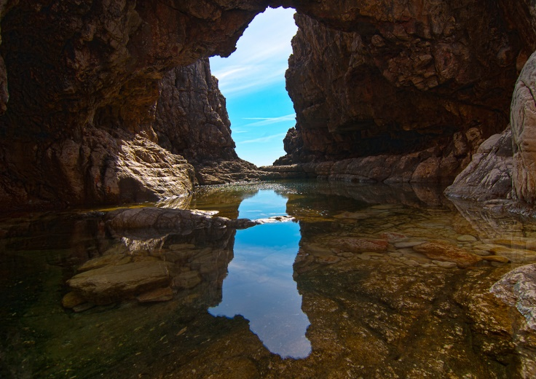
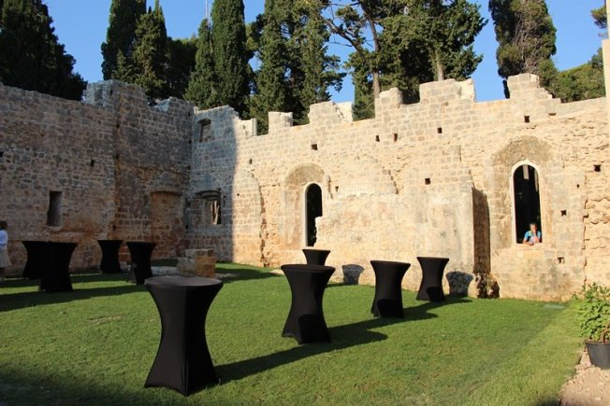
LOKRUM
Lokrum is an islet near Dubrovnik that is famous for good wine, its culture and beautiful gardens. Lokrum is known as saying that he keeps and looks after his inseparable Dubrovnik.
There is a botanical garden on it and is famous for its peacocks.
It is a special reserve of forest vegation by unesco protection
Lopud is an islet known for its natural beauties and beaches.
It is known as a small paradise on the Adriatic coast On this islet cars are not allowed Lopud is also known for its large number of old chapels and churches
It houses European's tallest palm trees
LOPUD

Slide 9
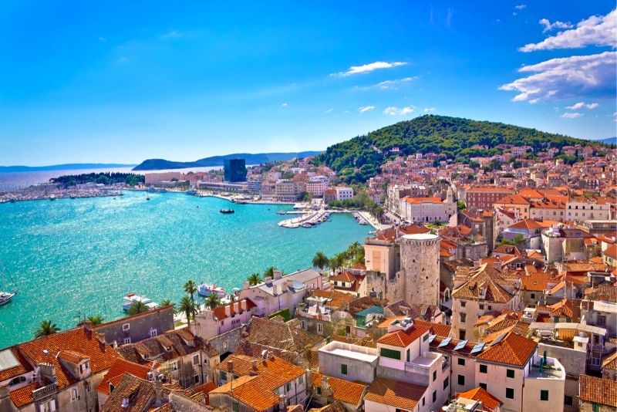
SPLIT

Slide 10
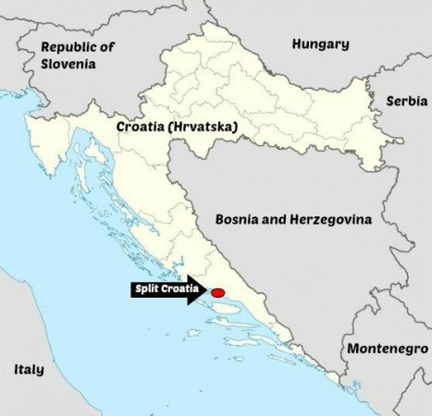
In general about Split
Split is the biggest city in Dalmatia, and has the largest population after Zagreb in Croatia
it is the center of economy and culture in Dalmatia attracting tourists from all around the world thanks to its many ancient sights.

Slide 11
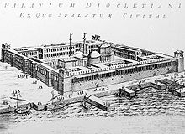
History of Split
The city was built as a Greek colony Aspalathos in the third – fourth centrury BC.
Later it became the residence of the Roman Emperor Diokletian.
In the seventh century Slavic tribes populated that part of Europe.
It was occupied by the Austrian Empire in 1813. It remained part of Austrian Kingdom of Dalmatia until the fall of Austro-Hungary with the end of WWI in 1918. and formation of the Kingdom of Yugoslavia
Diocletian’s Palace, 305. y.

Slide 12
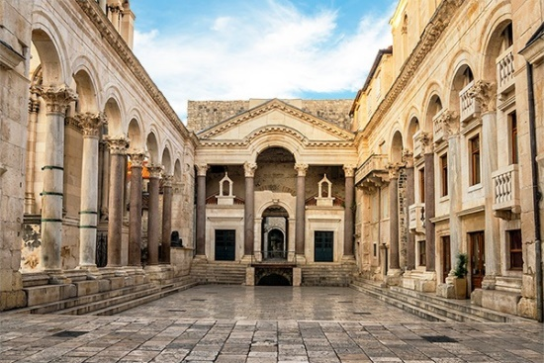
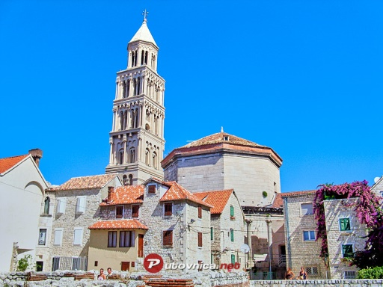
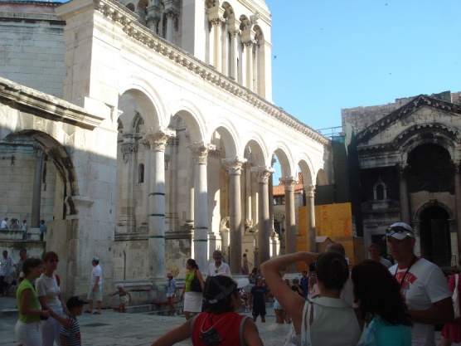
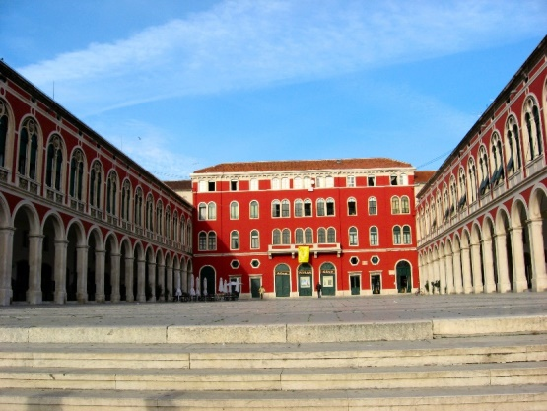
Culture of split
CULTURAL SIGHTS
Diocletian’s palace
Basements of Diocletian’s palace
Peristyle
Jupiter’s temple
Cathedral of St. Duje
Procurator
Gripe Fortress
Diocletian’s palace
Cathedral of St. Duje
Peristyle
Procurator

Slide 13
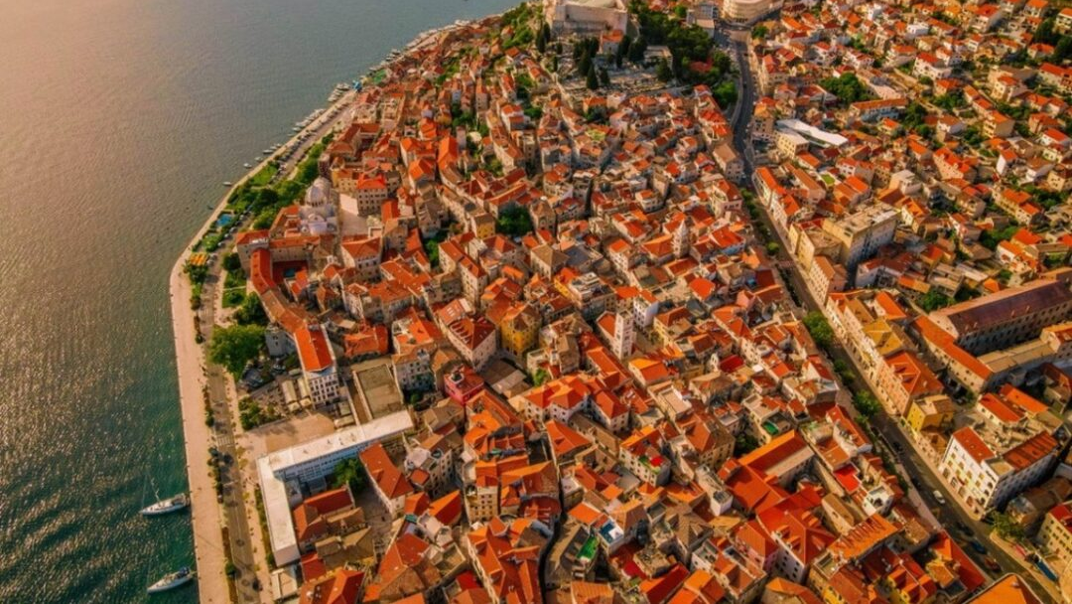
Šibenik

Slide 14
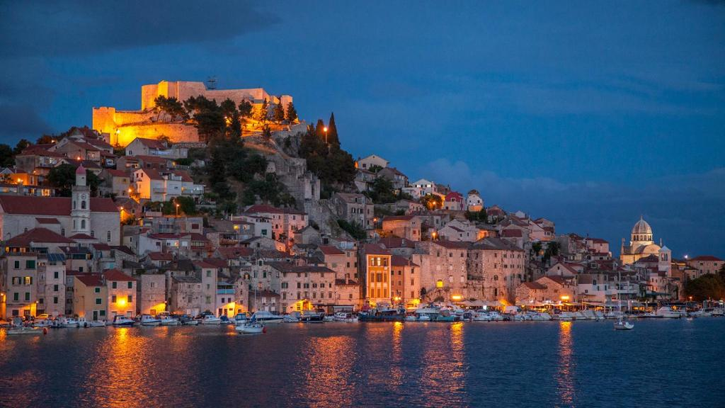
General facts about Šibenik:
Šibenik is a small Dalmatian town that can boast of various natural and cultural beauties.
Šibenik is the first city in the world that has received public lighting with alternating current.
Šibenik is often called Krešimir's town.

Slide 15
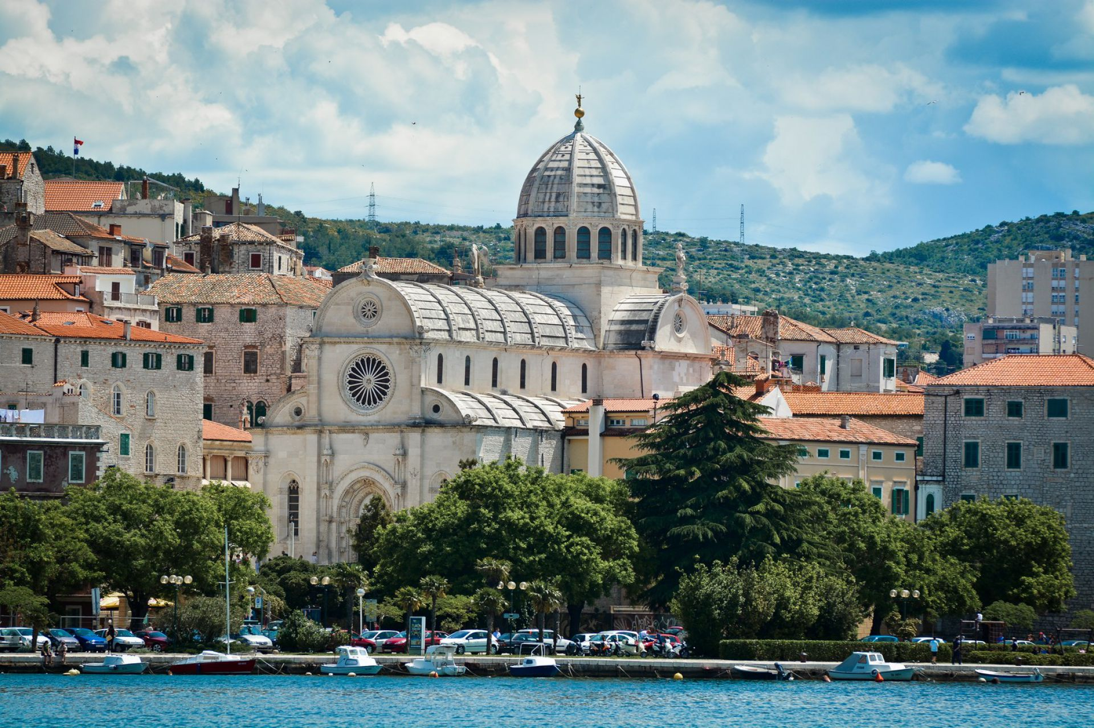
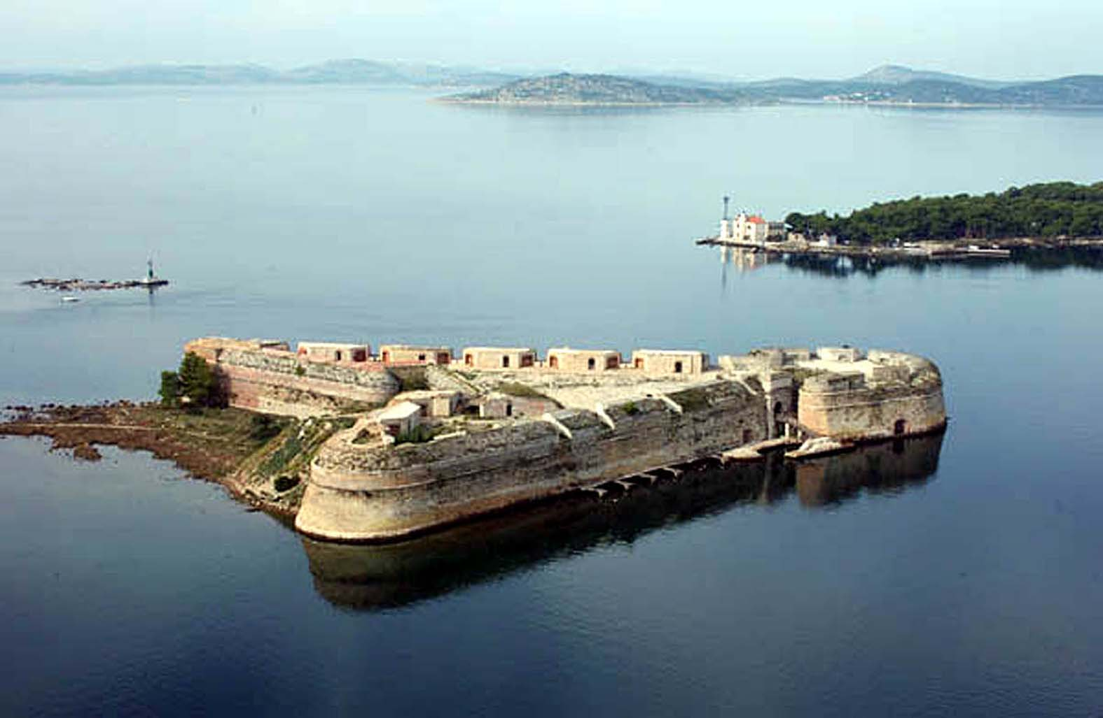
Monuments:
Šibenik has wonderful monuments which are:
St. Nicholas Fortress
Cathedral of St. James

Slide 16
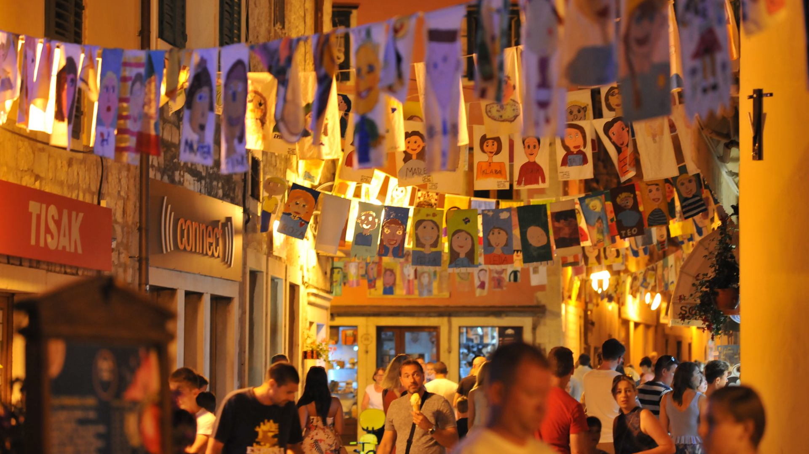
Festivals:
Šibenik has lots of wonderful festivals like:
International Children's Festival
Šibenik Dance Festival
Lots of music festivals like:
OFF Jazz & Blues Festival
Regius Festival
Nox Festival

Slide 17
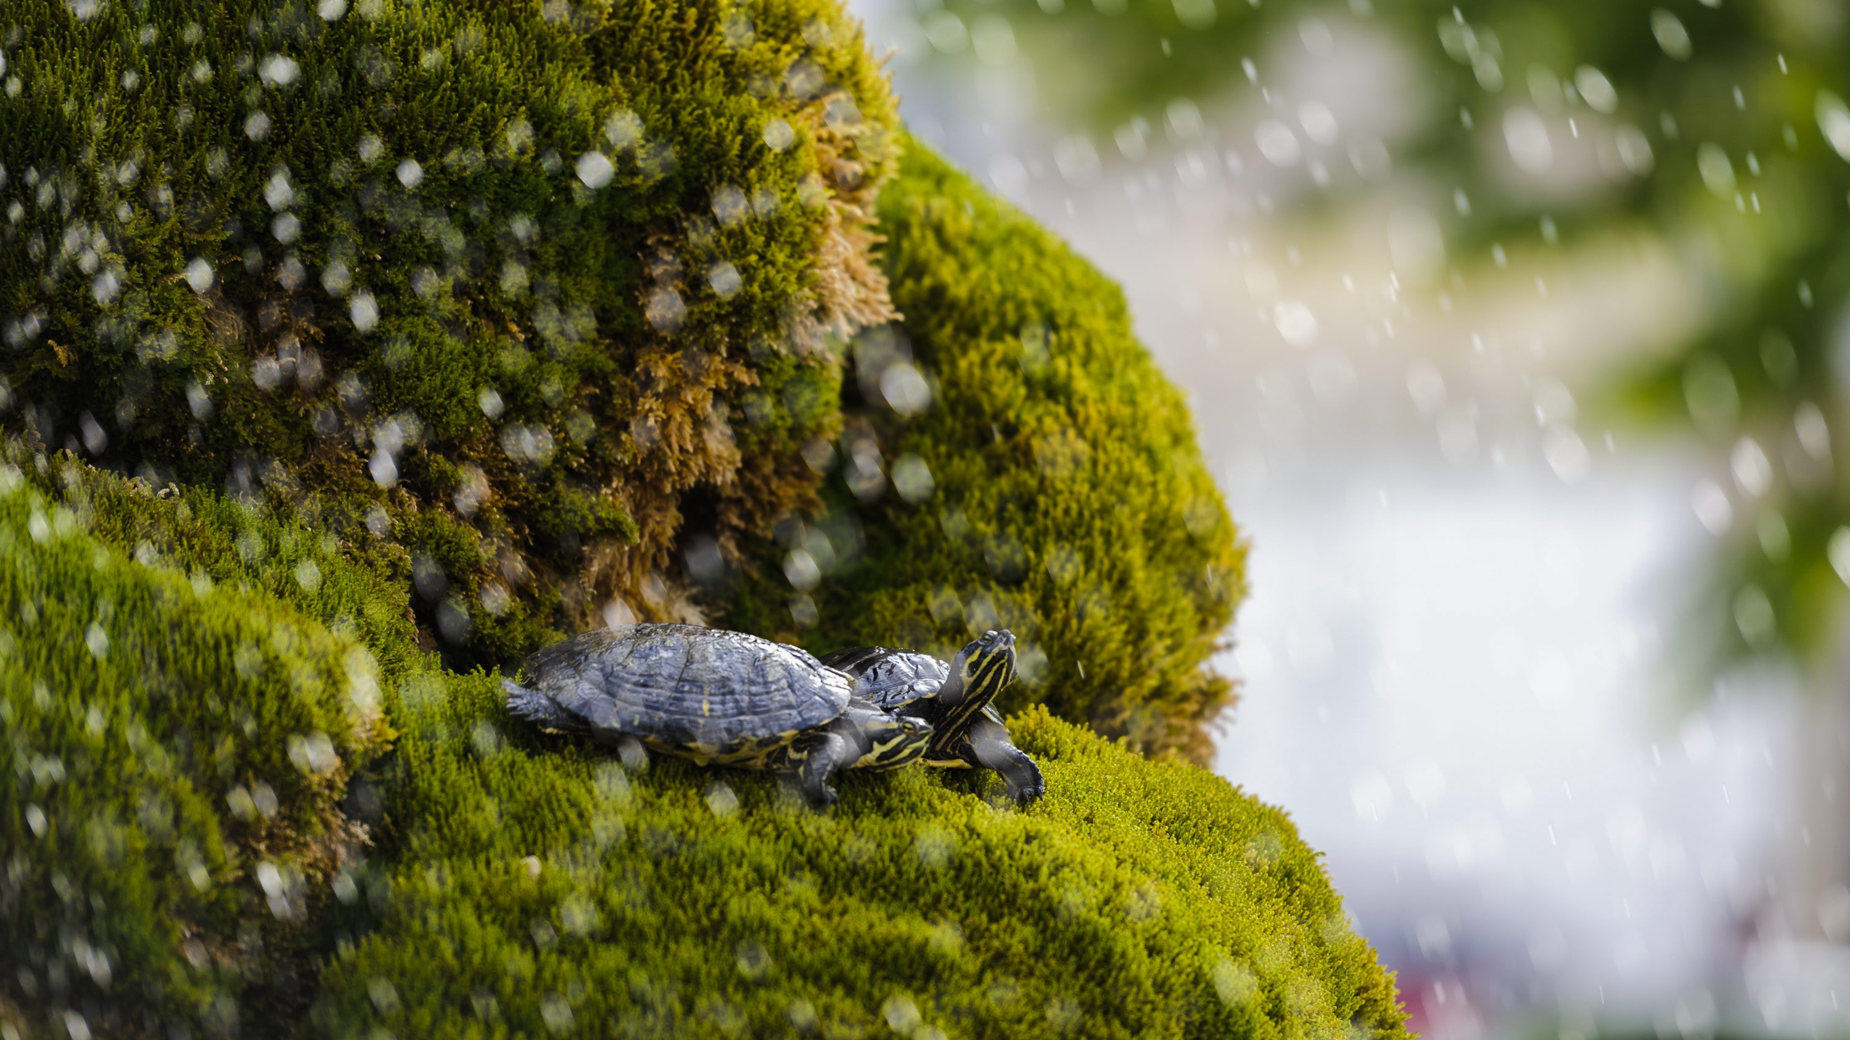
Attractions:
Šibenik has lots of wonderful attractions too like:
Šibenik’s old town hall
Šibenik’s wonderful monuments
Šibenik’s city museum
Šibenik’s wildlife

Slide 18
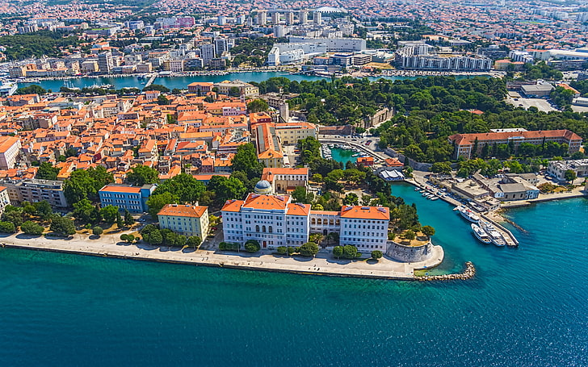
Zadar

Slide 19
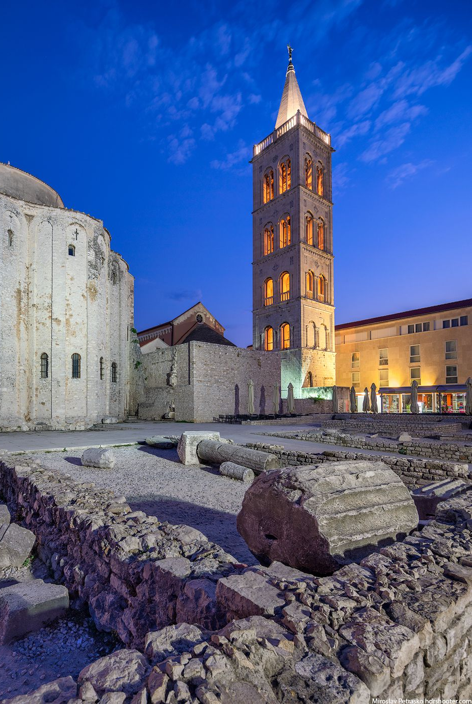
History
Zadar is a city whose past goes back 3,000 years.
It became a fully urbanized centre during ancient Roman Empire.
Even since those first records, Zadar has been one of the most important cities on the Eastern Adriatic coast.
With every step you take, its streets , squares, the seafront, churches and monumental heritage unveil its antiquity and continuity.

Slide 20
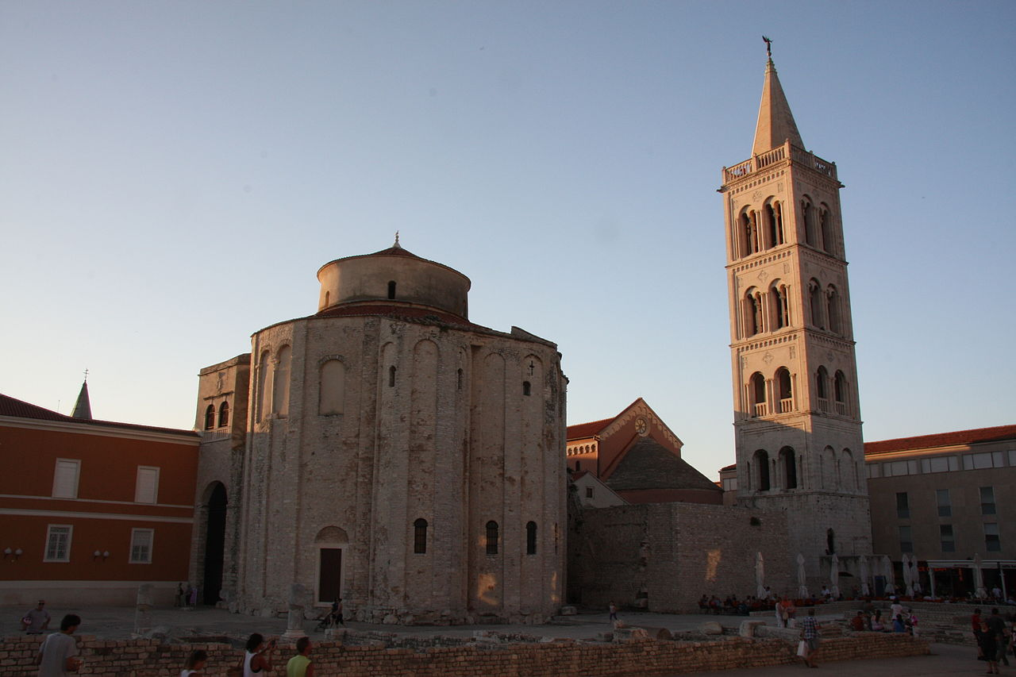
Attractions
Greeting to the sun
Church of St Donat
Zadar city walls
Kalelarga
Church of St Andrew and St Peter the Elder
Sea Organ and many more
Ta fotografija korisnika Nepoznat autor: licenca CC BY-SA

Slide 21
Church of St Donat
The Church of St Donat in Zadar has long been desacralized, meaning no liturgies are held here, anuntil 1954 it housed the Zadar Archeological museum
The monumental medieval monument was built in the 9th century on the model of early Roman arhitecture
It was first named the Church of the Holy Trinity, and then later it bore the name of Bishop Donat who had it built
It represents the most famous monument of Zadar.
Ta fotografija korisnika Nepoznat autor: licenca CC BY-SA

Slide 22
Sea Organ
The Sea Organ is an arhitectural sound art object located in Zadar
It plays music by way of sea waves and tubes located underneath a set of large marble steps
The device was made by the arhitect Nikola Bašić as part of the project to redesign the new city coast, the sights was open to the public on 15 April 2005
Ta fotografija korisnika Nepoznat autor: licenca CC BY-SA

Slide 23
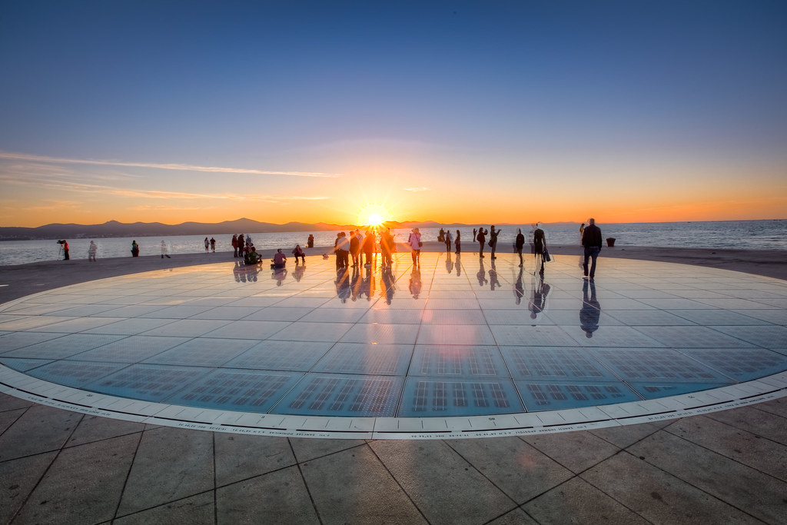
Greeting to the Sun
The new symbol of Zadar is located in the Zadar port on the western point of Zadar Peninsula
This contemporary installation is made of 300 multy-layered glass solar panels in the circular shape with a diameter of 22-meter.
The Greeting to the Sun is in the immediate proximity of the Sea Organ
Ta fotografija korisnika Nepoznat autor: licenca CC BY-NC-ND

Slide 24
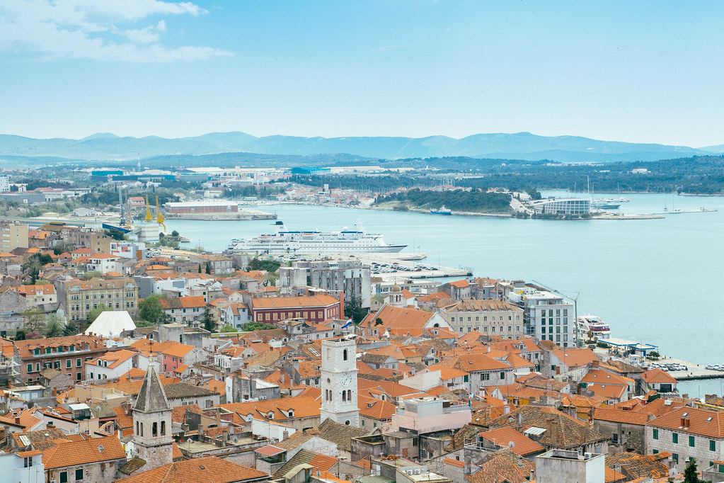
Surrondings of Zadar
If you are visiting Zadar you should also visit:
Šibenik
Vodice
Ugljan
Biograd na Moru
Nin
Vir
and a lot more…..
Ta fotografija korisnika Nepoznat autor: licenca CC BY

Slide 25
National Parks and Nature Reserves
National parks:
Kornati
Krka
Paklenica
Northern Velebit
Nature Reservats:
Telaščica
Vransko jezero
Velebit
Dinara
Biokovo

Slide 26
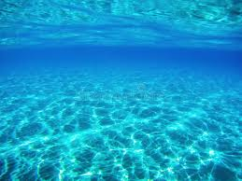
Thank You For Your Attention
Presentation made by:
Nikolina Medak, Melani Primorac
Nino Volarević, Duje Mihaljević
Tea Knežević, Petra Jelavić, Maja Primorac
Lana Musulin, Josip Sokol

